Slide 1
Classified Ad
Who are you?
What are you good at?
What positive personality traits do you have?
What is self-esteem?
Do you have a positive self-image?

Slide 2
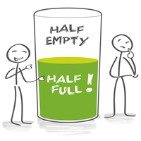
Classified Ad
What is self-esteem?
How we understand and value ourselves.
High self-esteem:
Likes oneself
Feel valuable
Do not feel like you have to be good at everything
Do not compare self to others
Accepting of others
Accept challenges; set goals
Low self-esteem:
Difficulty evaluating strengths & weaknesses
Negative impression of oneself
Take others opinions too seriously
Compare self to others
Often pessimistic (see the worst in things)

Slide 3
Classified Ad
What is self-image?
How you see yourself and how you believe others see you.
self-esteem
self-image
They are closely connected because if you have a poor opinion of yourself your self esteem will be low.

Slide 4
DIRECTIONS: Complete a personal inventory to help you recognize who you are and positive qualities about yourself. Follow each set of directions by filling in the blanks or checking the answers that apply to you.
What did you learn about yourself?
How can you apply this information to your life?
How does it affect goals you have set for yourself?

Slide 5
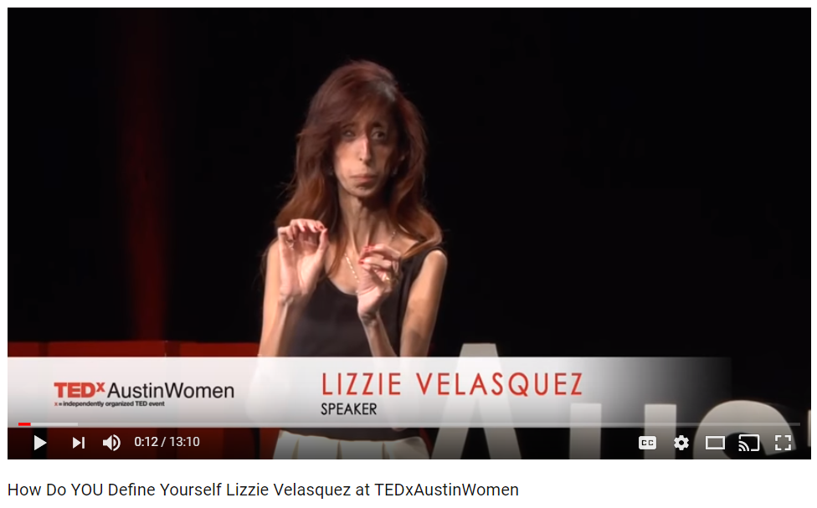
Classified Ad

Slide 6
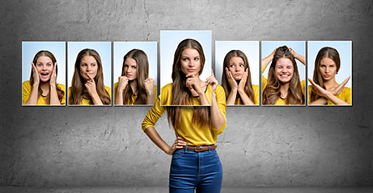
Classified Ad
How do you define yourself?

Slide 7
Classified Ad

Slide 8
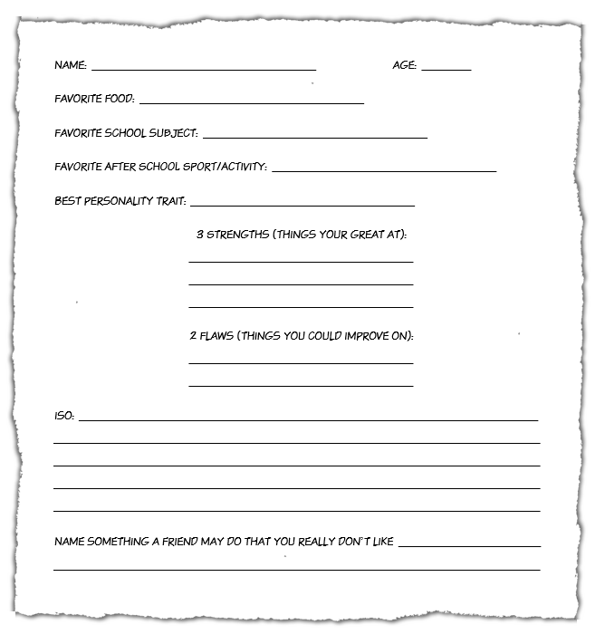
Why should you share
your flaws?

